Slide 1
Project presentation - Ram Kaminwar

Slide 2
Project – 1 using python and sql database connections

Slide 3
Project Overview: Parking Management System
This console-based Parking Management System is designed to streamline vehicle entry and exit operations in parking facilities. Developed using Python for logic and SQL for data handling, the system offers a simple yet powerful interface for managing real-time parking activities
Key Features
Vehicle Entry: Records incoming vehicles with timestamp and vehicle details.
Vehicle Exit: Calculates parking duration and generates applicable fees.
Fee Calculation: Dynamic fee computation based on time spent.
Export to CSV: Allows exporting parking records for reporting and analysis.
Help & Instructions: Built-in guidance for users to navigate the system easily.

Slide 4
Why This Project?
Promotes automation in manual parking systems.
Enhances accuracy in fee calculation and record-keeping.
Offers scalability for future GUI or web-based upgrades.
- Demonstrates integration of Python scripting with SQL databases

Slide 5

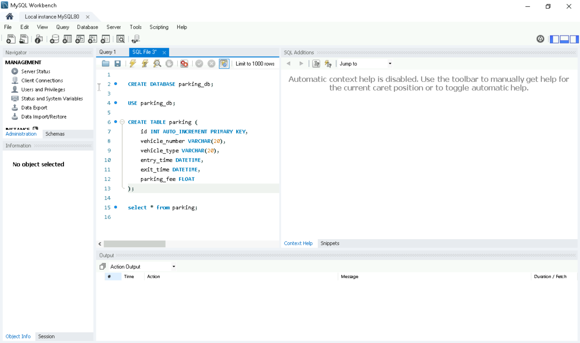
Overcoming nervousness

Slide 6
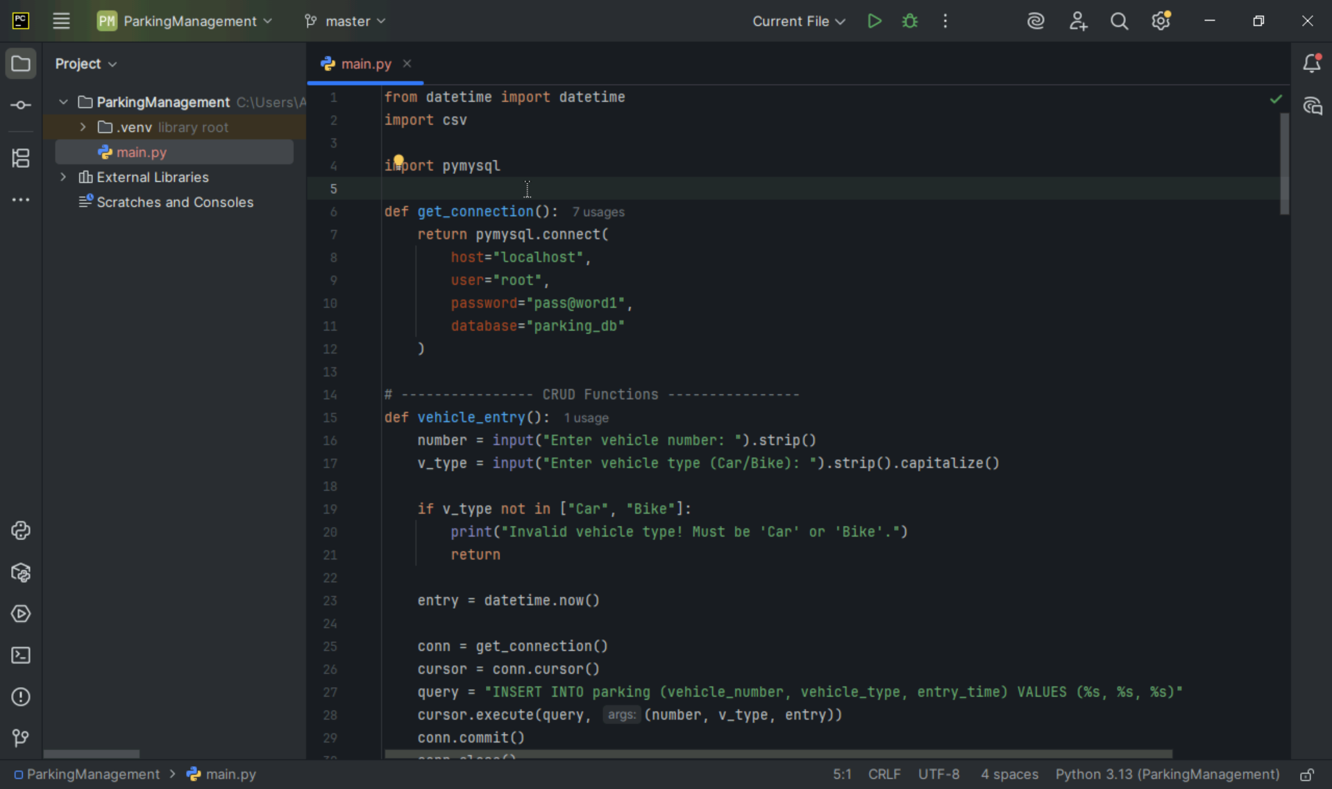

Slide 7
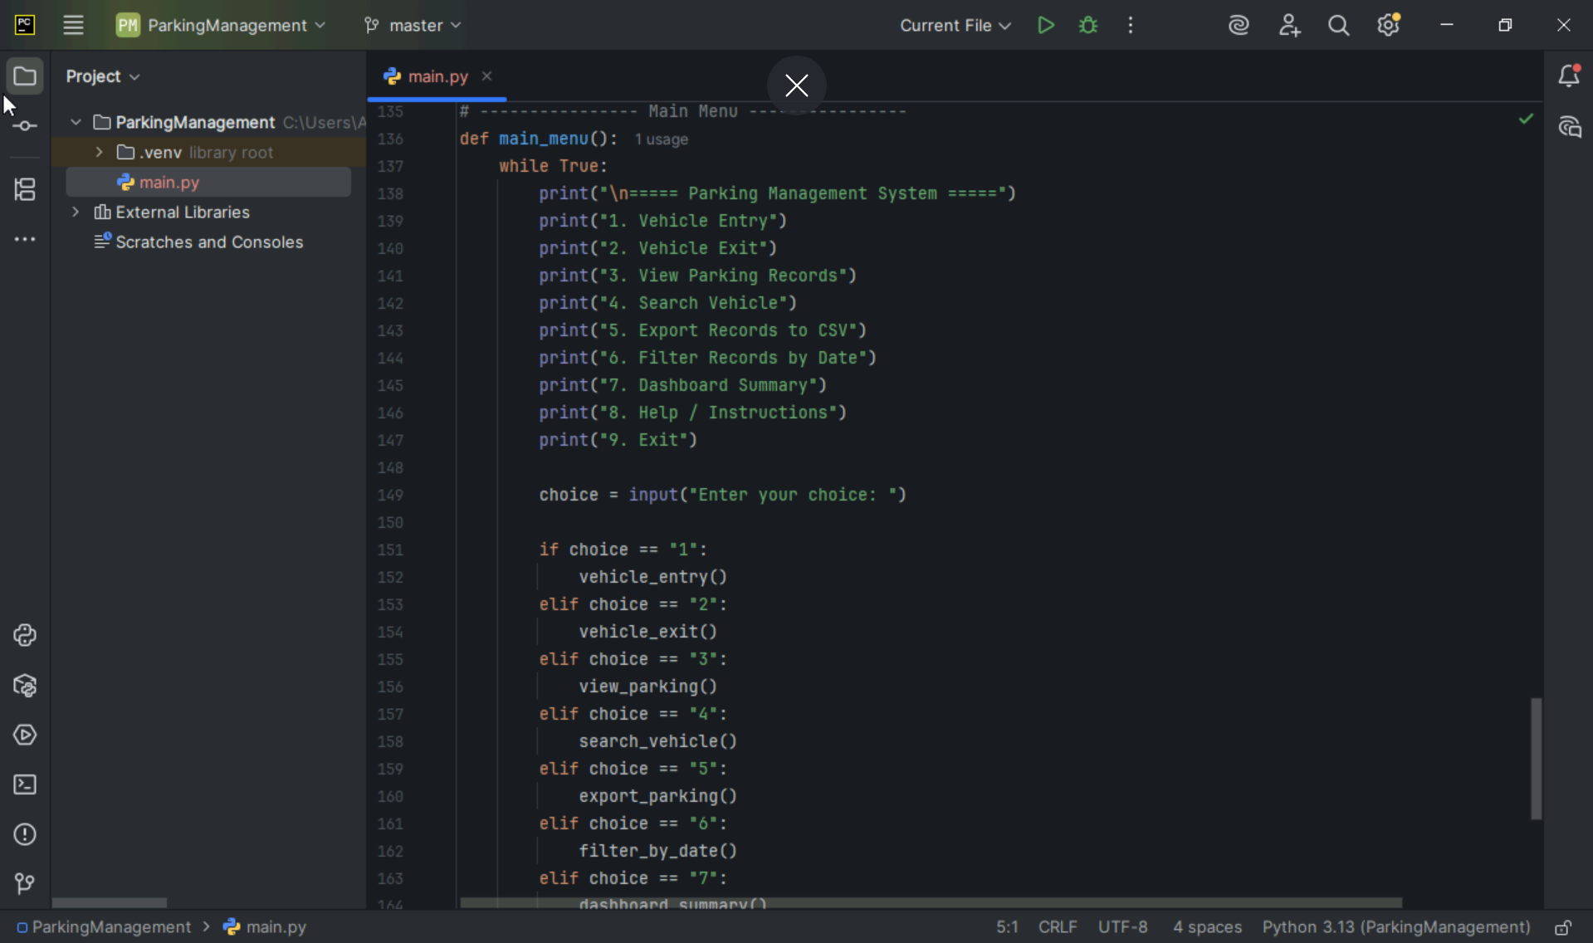

Slide 8
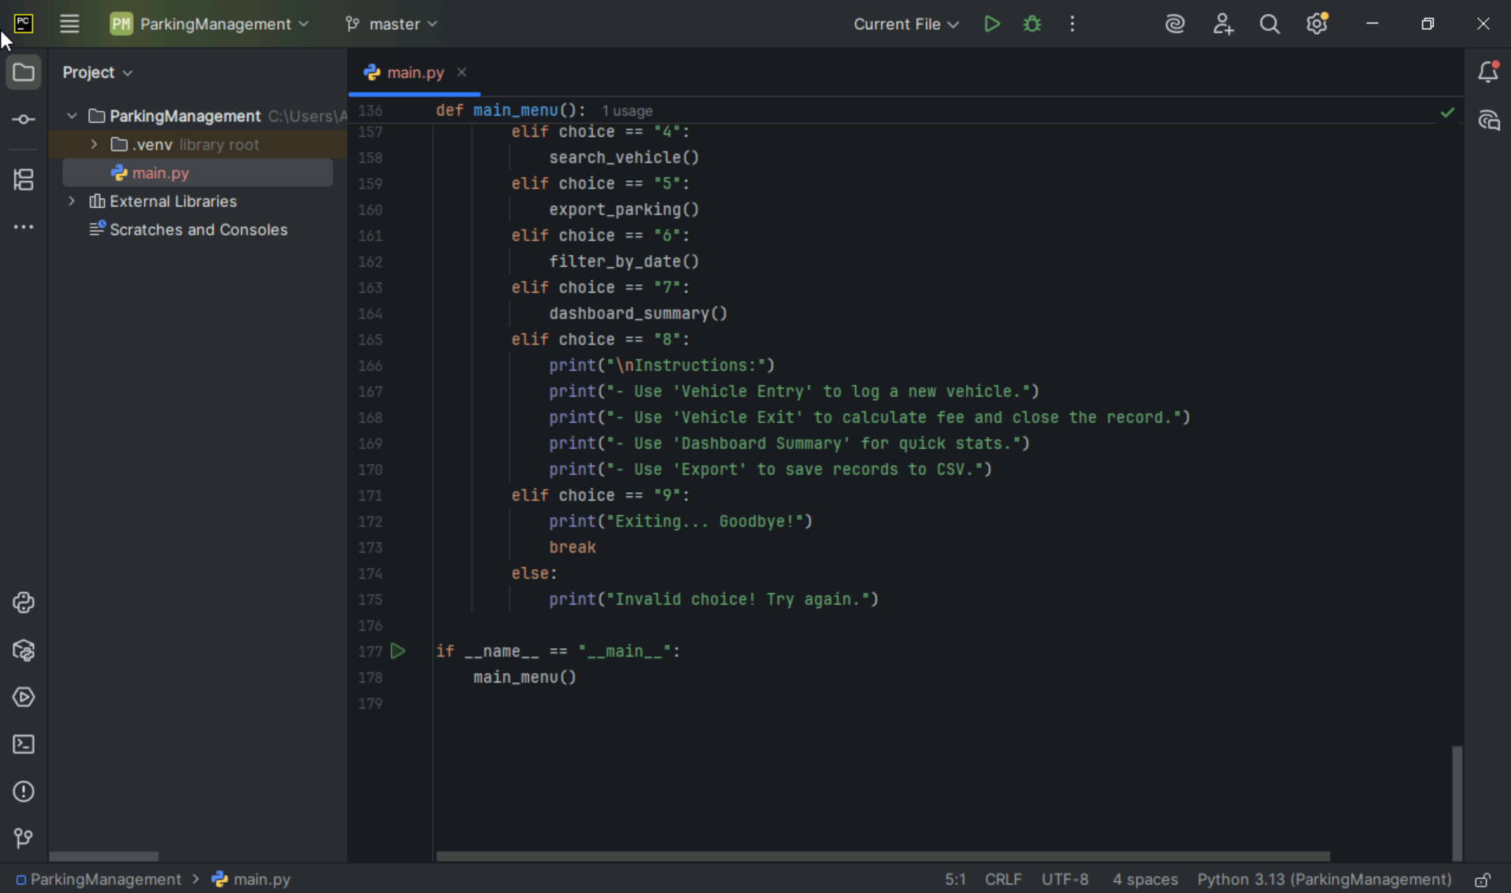

Slide 9
Project – 2 using springboot, docker, github, jenkins

Slide 10
Project 2: RESTful Web Display with DevOps Integration
This project is a learning-focused implementation that demonstrates how to build and deploy a simple RESTful web service using Spring Boot, while integrating modern DevOps tools like Docker, GitHub, and Jenkins
What the Project Does
Exposes a REST API that prints structured messages on the web.
Demonstrates GET endpoints for basic data display.
Focuses on clean code, modular structure, and best practices.
Uses Docker to containerize the Spring Boot app.
Automates build and deployment pipeline using Jenkins.

Slide 11
Technologies Explored
In this project, I worked with a powerful combination of backend and DevOps tools:
Spring Boot – Used to build and expose RESTful web services with minimal configuration.
Docker – Enabled containerization of the application for consistent deployment across environments.
GitHub – Served as the version control platform for managing code and collaboration.
Jenkins – Automated the build and deployment pipeline, showcasing continuous integration in action.
Each technology played a key role in demonstrating how modern web applications are developed, deployed, and maintained efficiently.
Would you like help turning this into a slide with icons or a visual tech stack layout?

Slide 12
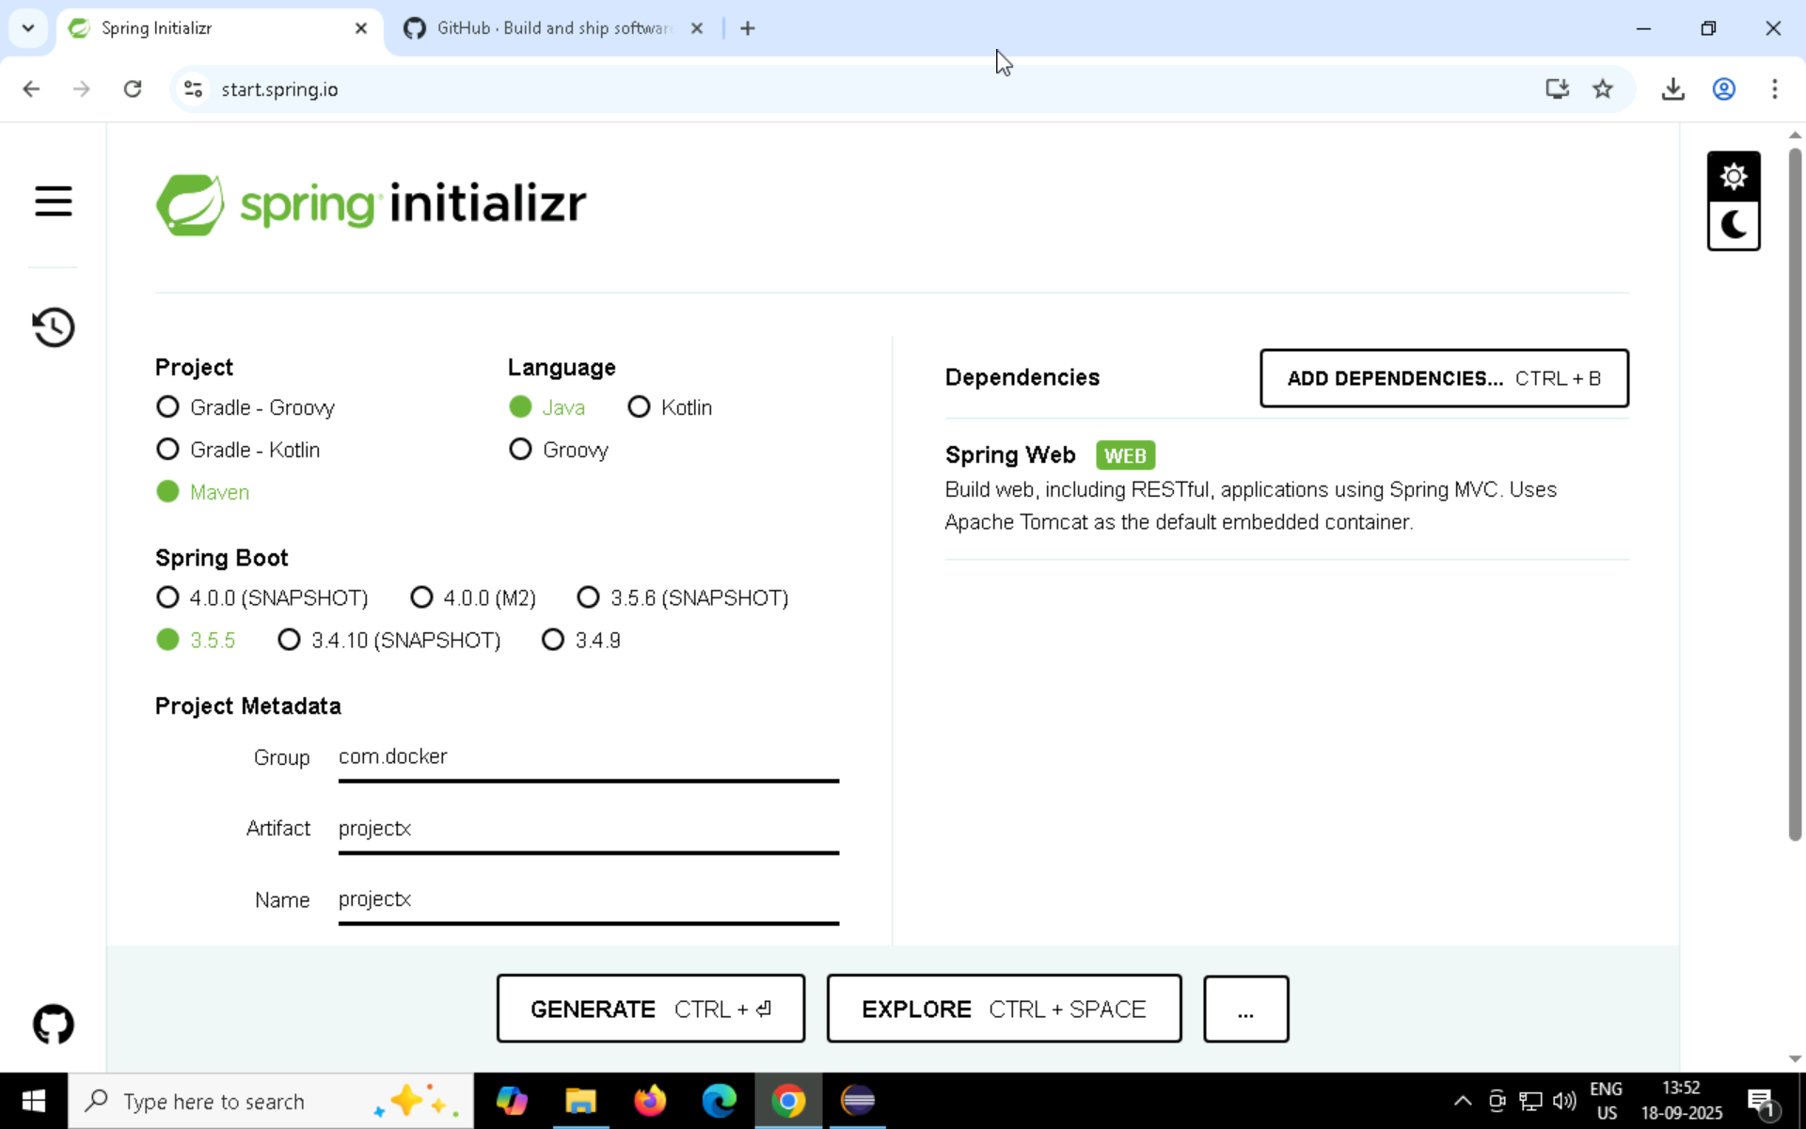

Slide 13
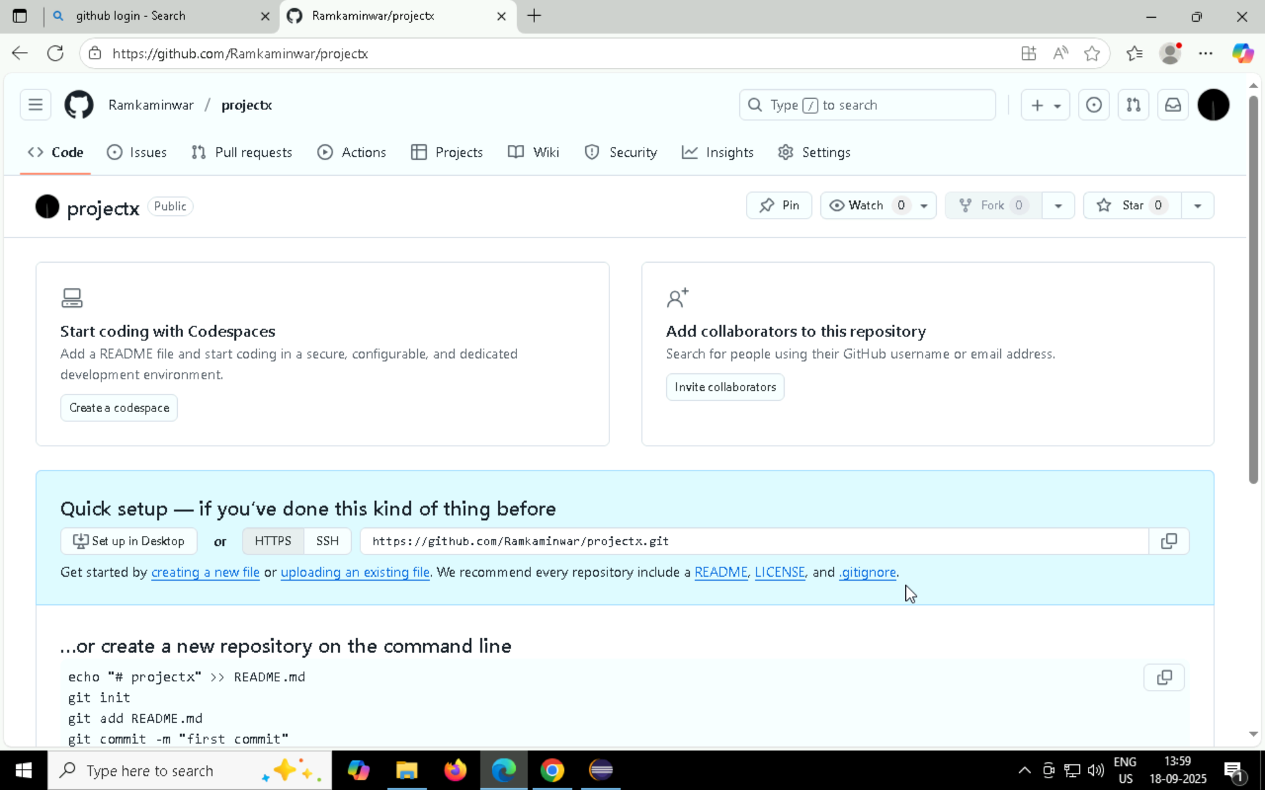

Slide 14
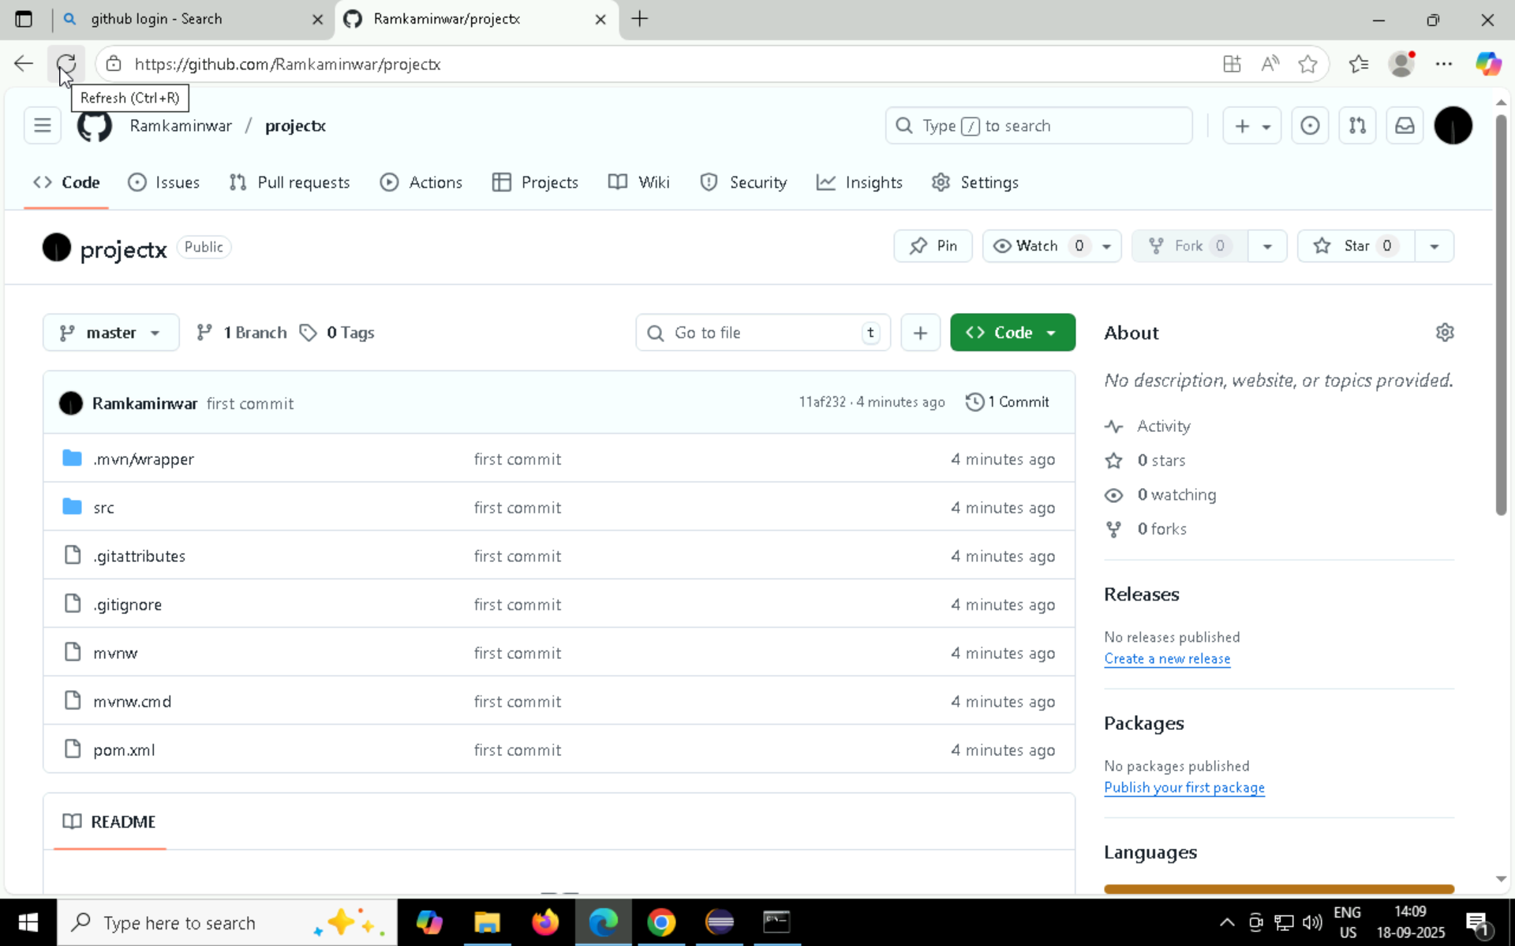

Slide 15
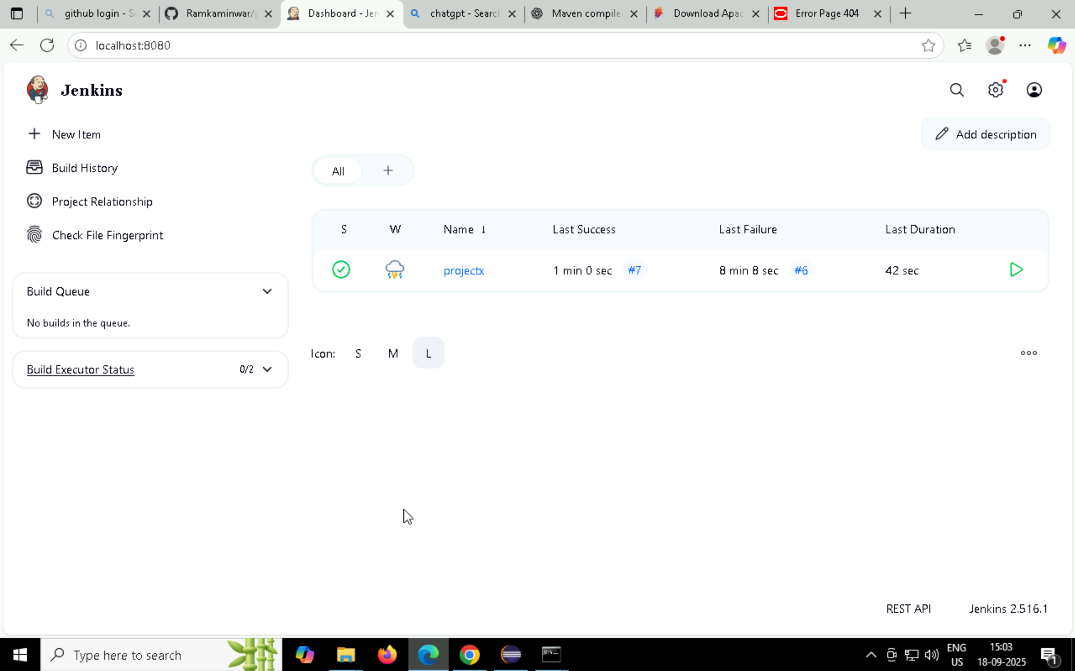
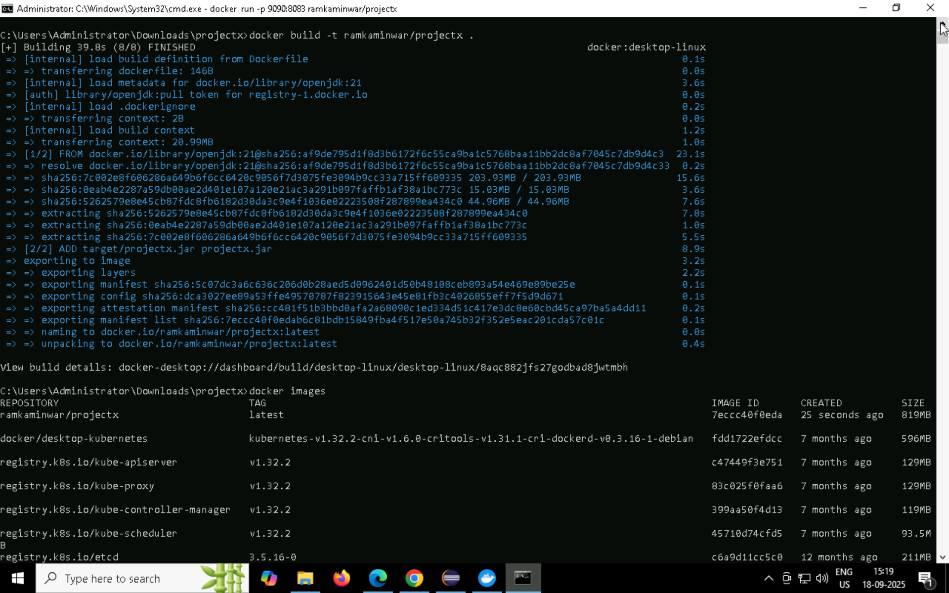

Slide 16
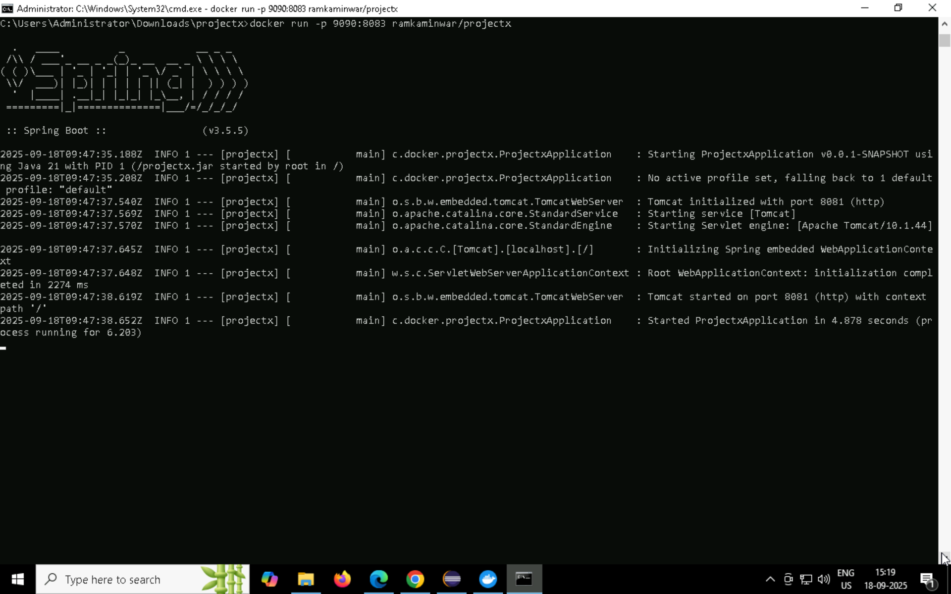

Slide 18
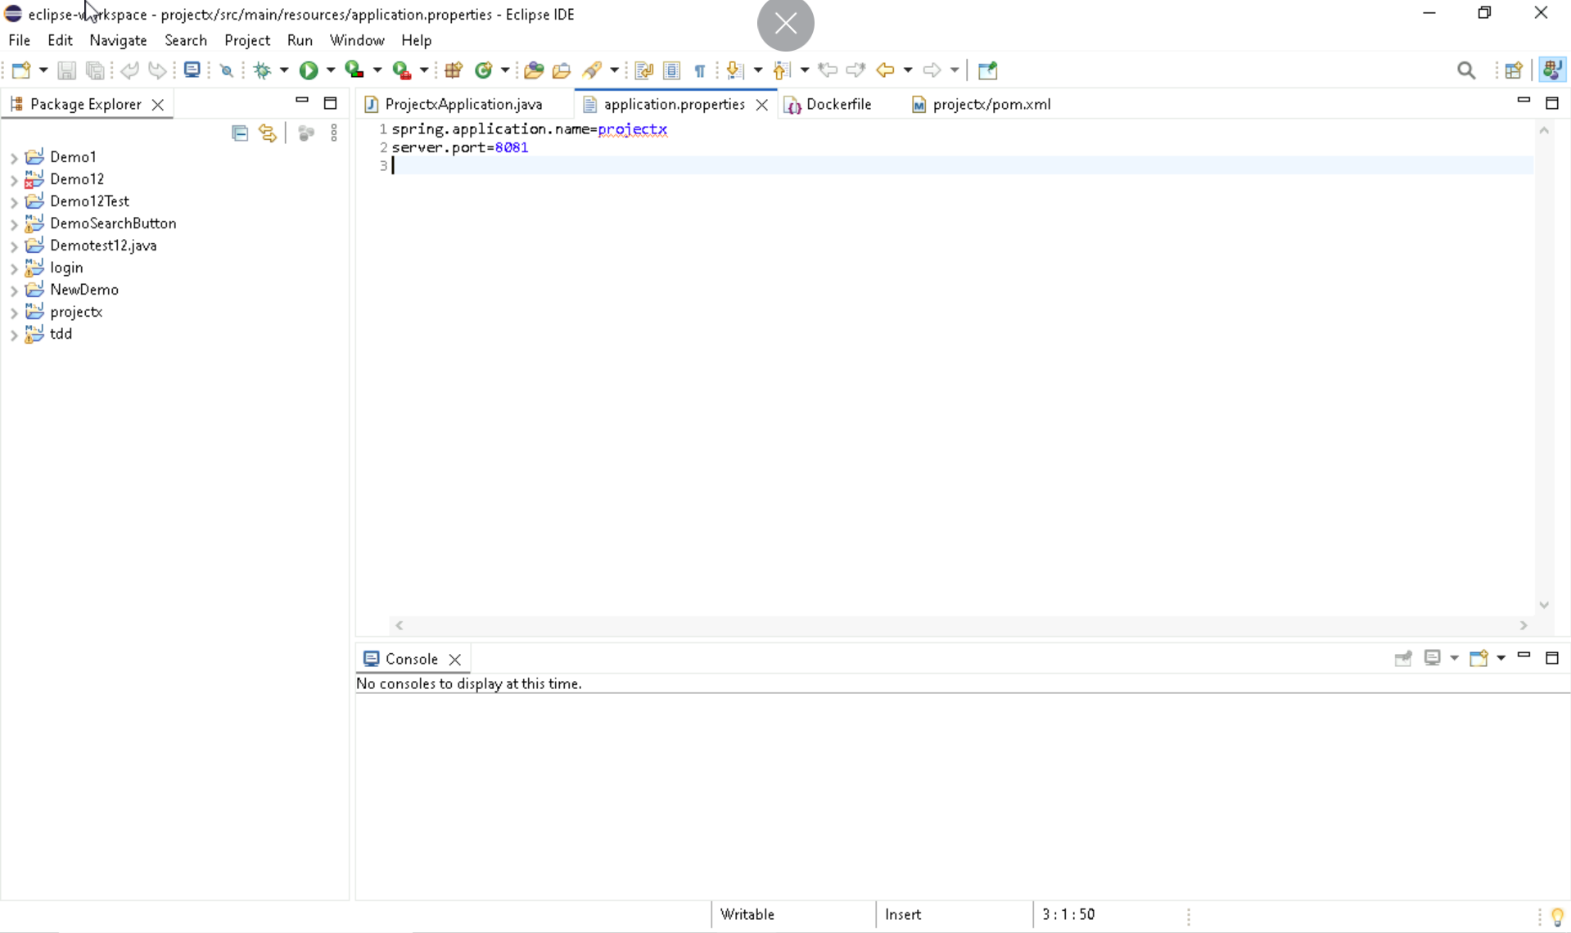

Slide 19
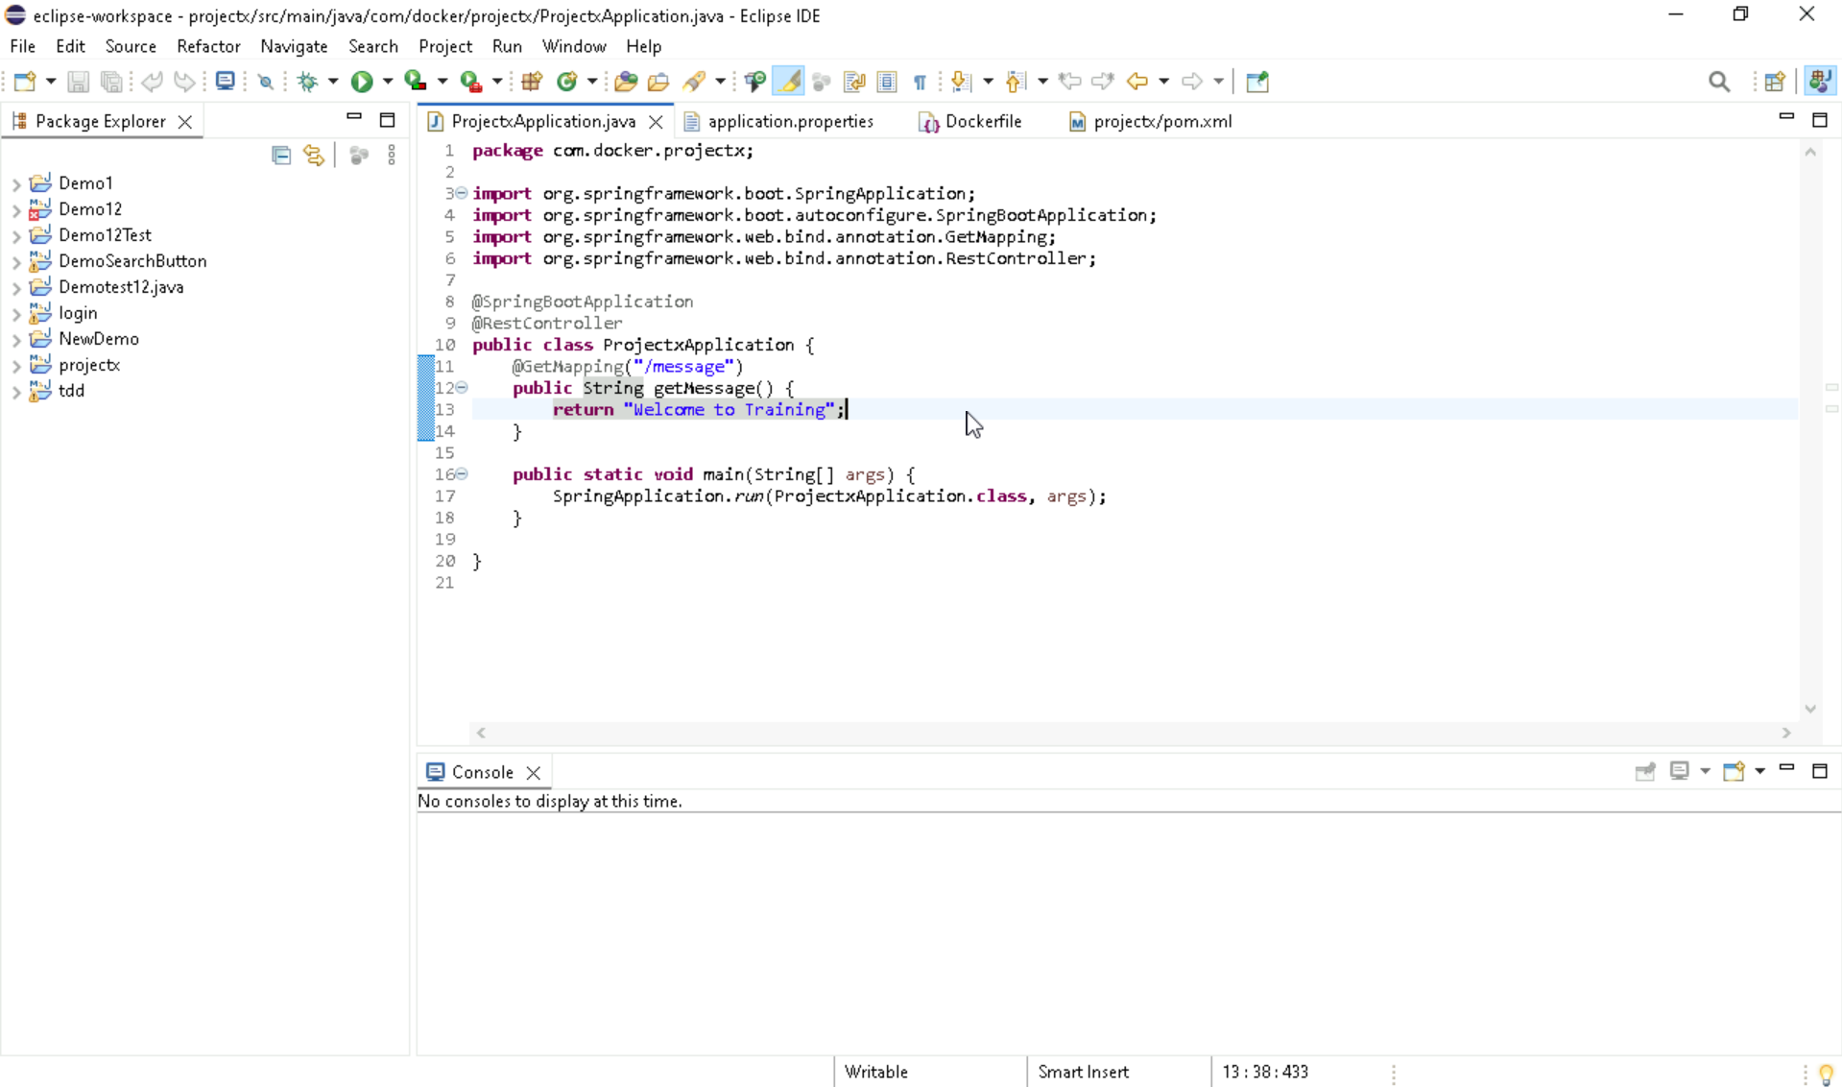

Slide 20
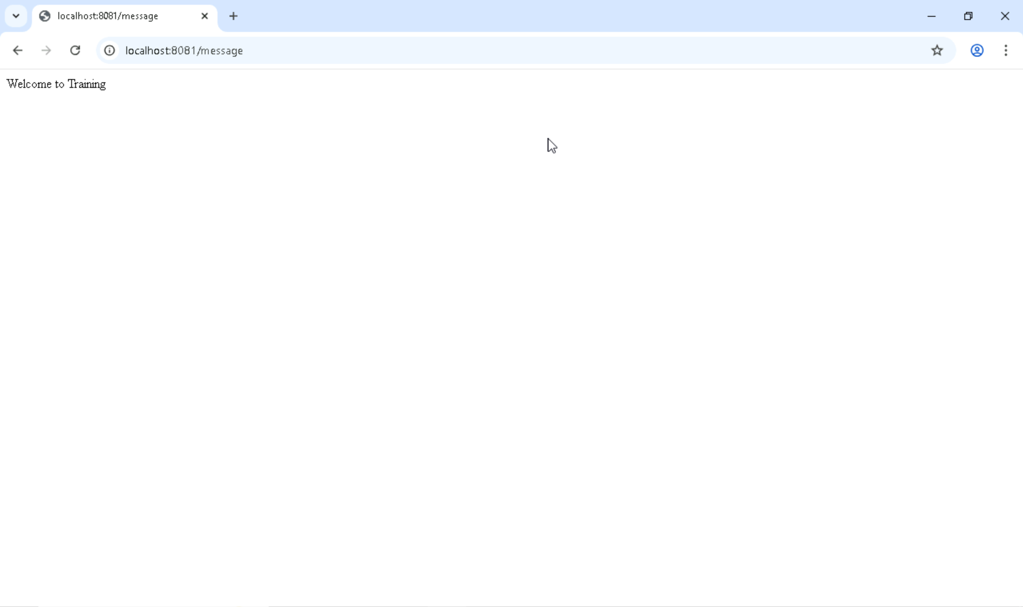

Slide 21
THANK YOU

